Slide 1
Jan Brett
An Author/Illustrator Presentation
by Lauren A. Bartoe

Slide 2
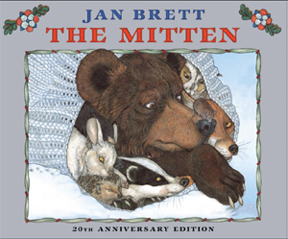
Early Impressions: The Mitten
Perhaps the most universally known work by Jan Brett is her 1989 book, The Mitten. For many children, this is the first exposure to Brett’s breathtakingly detailed illustrations, which take the reader directly into the snow-laden clearing to feel the brisk winter air on his or her cheeks and the crunch of fresh powder snow underfoot. I can recall a first-grade activity in which we filled our own oak-tag mittens with the appropriate paper animals as the story was read to us by the teacher. At the time, the interaction with the story was most engaging.

Slide 3
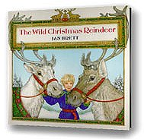
Early Impressions: The Wild Christmas Reindeer
Though I now recall The Mitten as my earliest Brett experience, the moment in which my appreciation for Brett’s work was born occurred a bit later. In around second or third grade, my mother introduced me to The Wild Christmas Reindeer (1990). We spent more time examining the artwork around the borders of the pages than reading the words of the story itself. Brett has a gift for visual engagement— bringing another level of literary experience to young readers besides mere depictions of the story’s action.

Slide 4
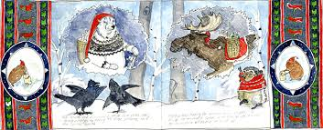
Jan Brett as Author/Illustrator
As a beloved household name for many families who read or have read children’s books, Brett certainly is a skilled storyteller, providing unique perspectives on common themes and symbols. The culture that Santa Claus and his elves “live” is explored, as are “communities” of woodland creatures. Brett is able to bring an additional layer of whimsy and fresh enchantment to settings that are already familiar and inviting to children. Just when a child thinks she knows the story behind Santa Claus, a charming account from Brett revives the magic and intrigue.

Slide 5
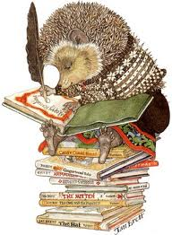
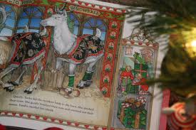
Jan Brett as Author/Illustrator
While Brett’s stories are themselves expertly crafted to enchant the child, it is her illustrations that set Brett apart from other children’s authors. Brett has admitted that her childhood dream was to become an illustrator, and her continued determination to achieve that goal throughout her life is evident in her work. Her intricate illustrations provide a second level of engagement for readers. Children and adults alike may find themselves poring over single pages to explore the detailed illustrations long after they have read the printed words.

Slide 6
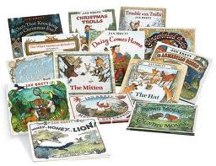
Jan Brett Legacies
Brett produces the type of children’s literature that becomes part of family tradition over generations. Once a family discovers The Mitten and learns that Brett has a prolific collection of equally stunning work, the collections begin to grow. Personally, I initiate those collections for many of my loved ones, presenting The Mitten as a gift to the newborn babies of friends and relatives. The fact that many of Brett’s titles are available as board books makes this an even more appropriate gift. Well beyond those childhood years, appreciation for Brett’s work transfers over into a representation in our adult collections—I would doubt that I am the only one with a Jan Brett shelf on my bookcase.

